Slide 1
Procedural Generated Maze Game Application
By Joshua Phillips
For Coder Academy 2023 Term 1 Assignment 3

Slide 2
Features
Generation of ASCII maze: main feature of application
Single Maze gaming mode: terminal play of generated maze
Setting Maze wall colour: customisation of maze colour
Output Maze to .txt file: save a maze in plain text file for offline play/printing

Slide 3

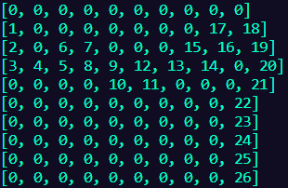
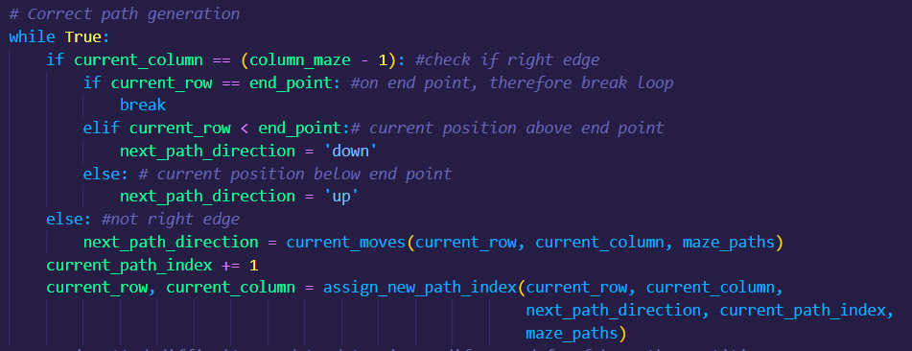
Features: Generation of ASCII maze
maze_generator.py
Correct path generated

Slide 4
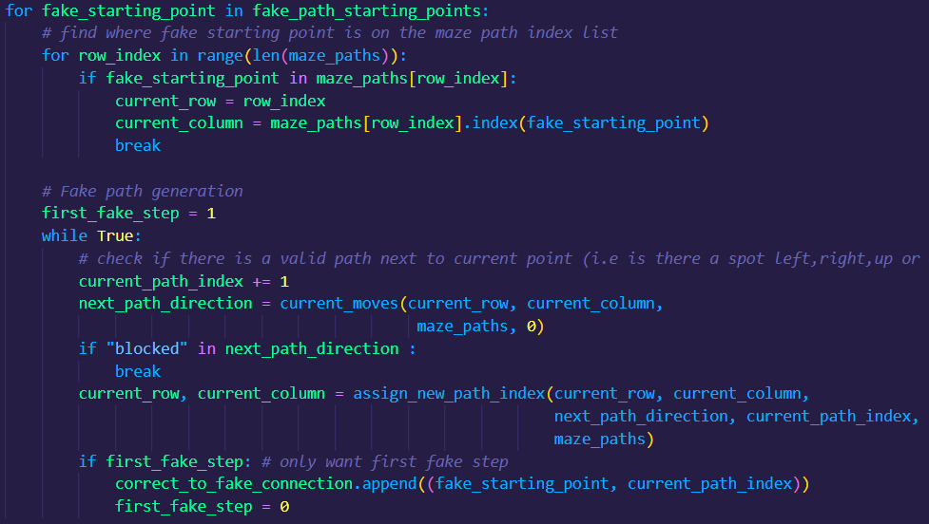
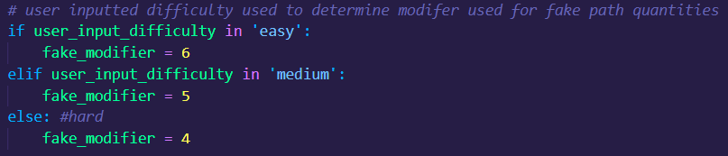
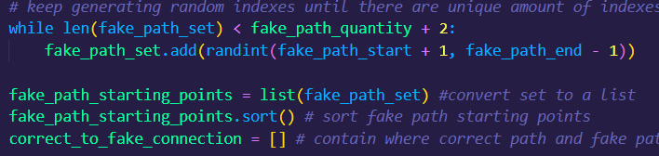
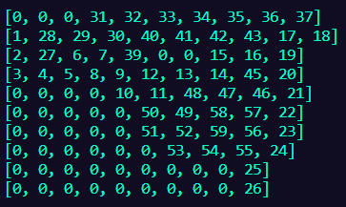
Features: Generation of ASCII maze
maze_generator.py
Correct path generated
Fake paths generated around correct path

Slide 5
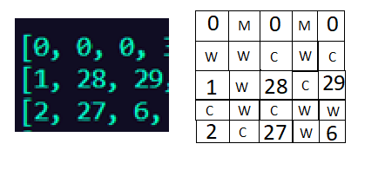
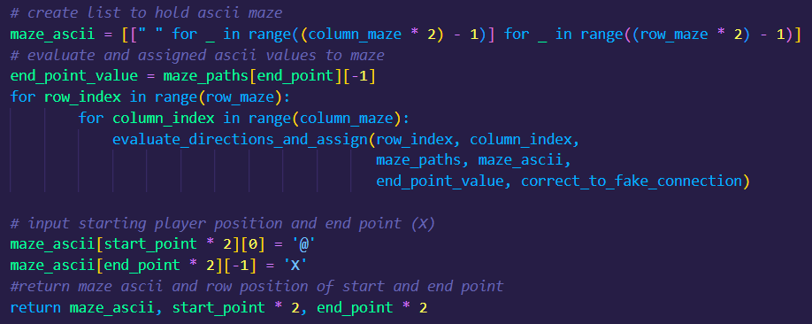
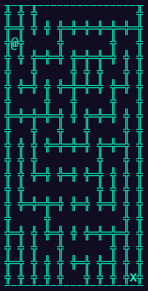
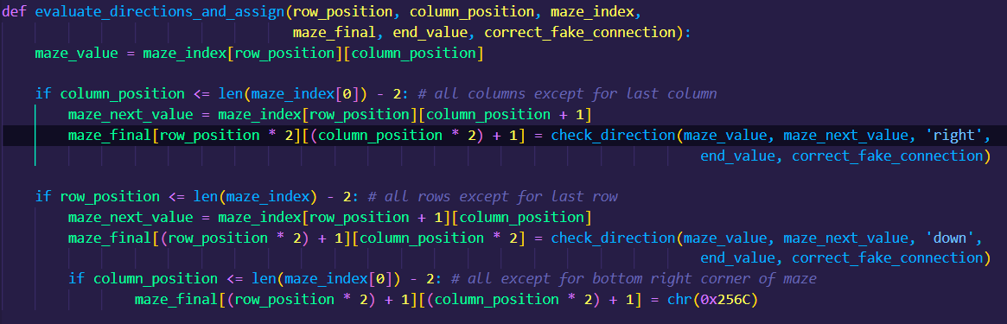
Features: Generation of ASCII maze
maze_generator.py

Slide 6
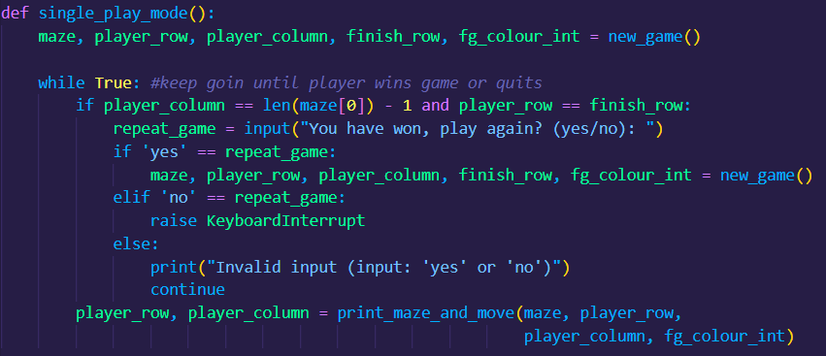
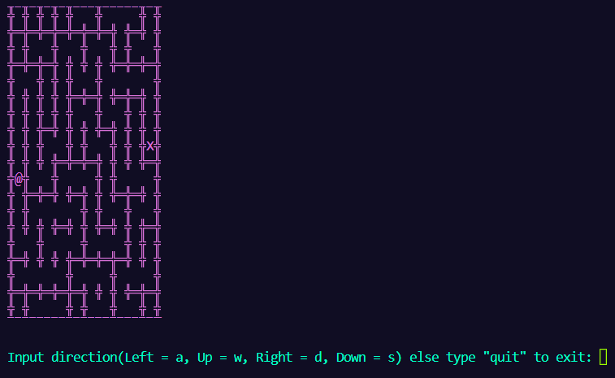
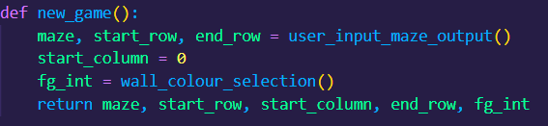
Features: Single Maze gaming mode
maze_modes.py

Slide 7
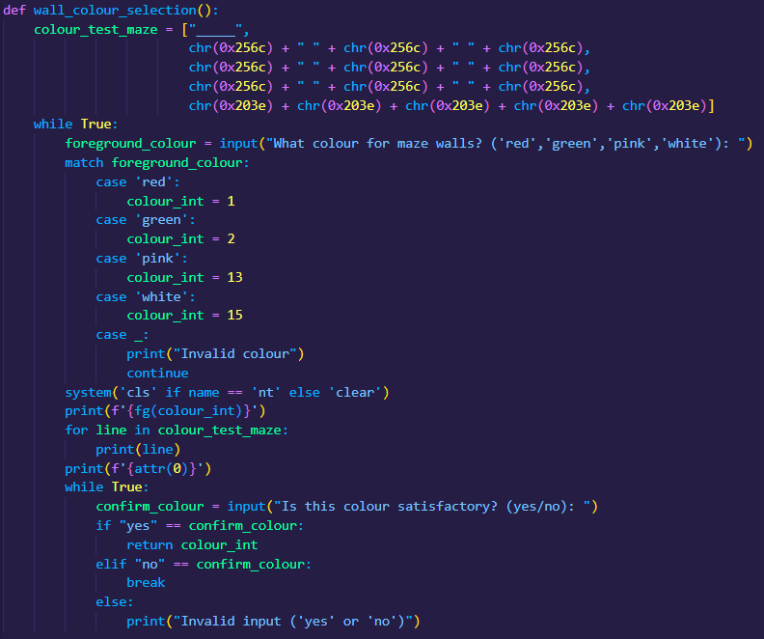
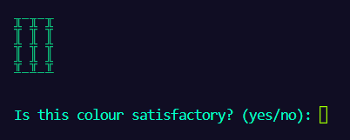
Features: Setting Maze wall colour
maze_modes.py

Slide 8
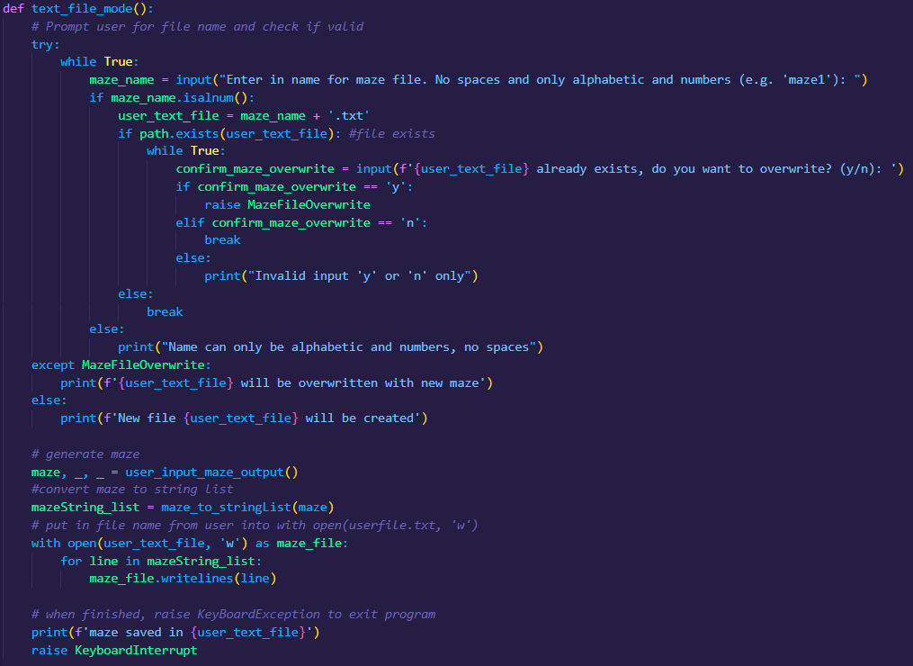
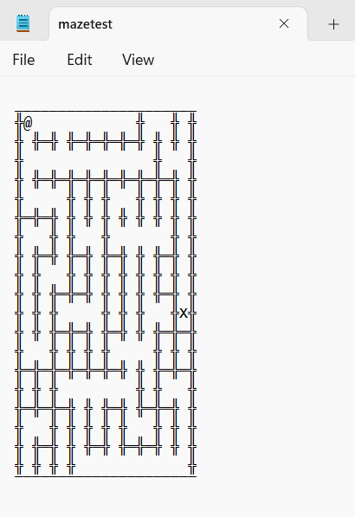
Features: Output Maze to .txt file
maze_modes.py

Slide 9
Live demo: How to use application

Slide 10
Review of application project
Good learning experience. Got better at problem solving and python coding, especially error handling.
Challenged initially on how to create a maze.
Would of liked to do more test driven development.
My Bash script is a bit too simple. Would like to learn more about it.
Trello board was a big help.

